Slide 1
CSS – Responsive Web Design
SE 3355 Web Development
Lect. Barış Ceyhan

Slide 2
Motivation
Make webpages beautiful, not just functional
Make use of frameworks without having to change html

Slide 3
CSS - Basics
Cascading Style Sheet. .css files. Makes pages nice. Layer on top of html
Does not control FUNCTIONALITY. Want a button do something? CSS cant help u
Technically CSS is optional. If you want to make good sites, app; it is NOT

Slide 4
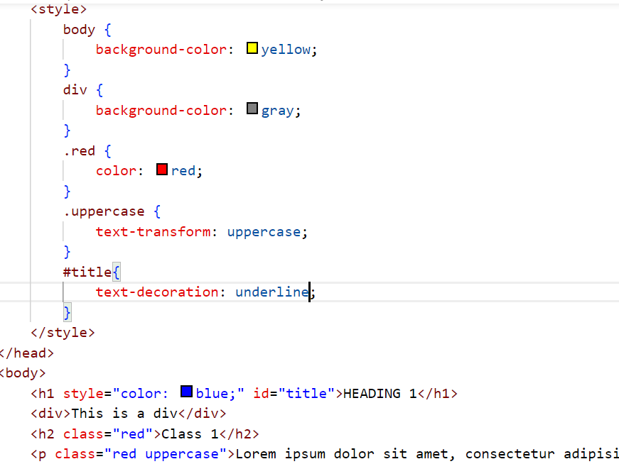
Selectors
Inline (not best practice, why?) or internal
It is all about SELECTORS
Select h1, divs
Using class selector, multiple classes. Case-sensitive, important
Using id selector. Id – unique. As in PK

Slide 5

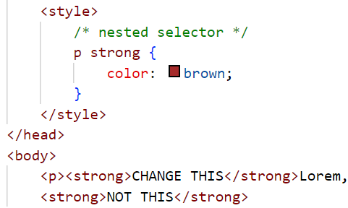
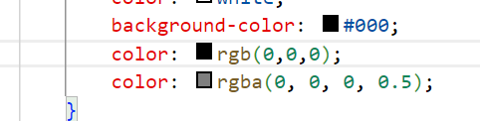
Selectors, color
Multiple selectors
Nested Selectors. How far can u nest?
Notice CSS comments. Shortcut Ctrl – Cmd /
Ways to color. Hex, rgb, rgba

Slide 6
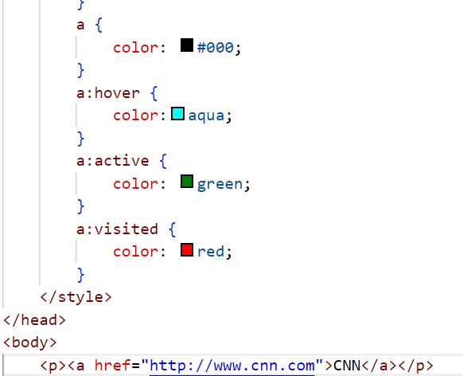
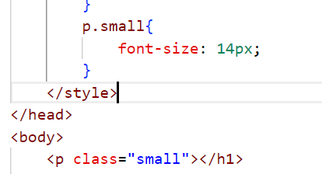
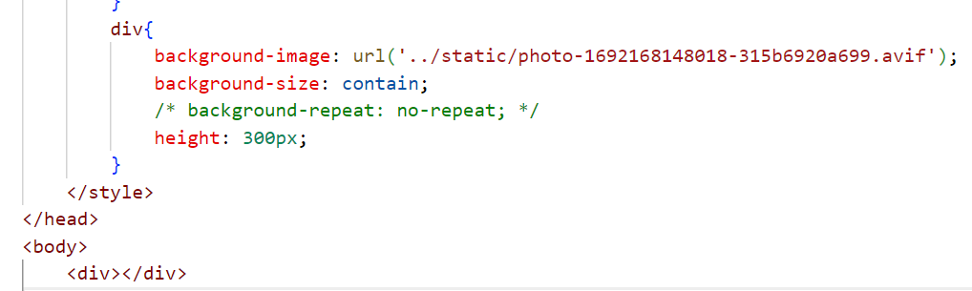
Links, measurements, background
a . hover, active, visited
font-size –> by class selector
px,em,rem – measurement types
background-image, size
Always inspect – learn more – it is a playground

Slide 7
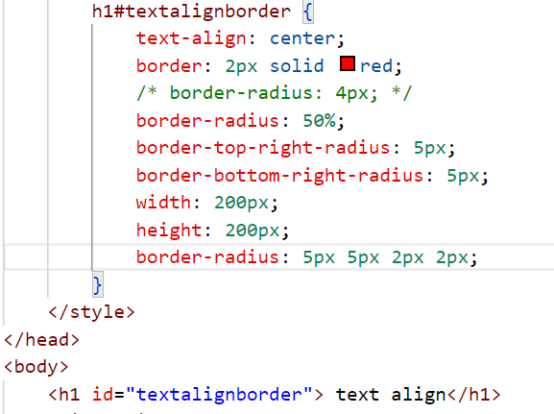
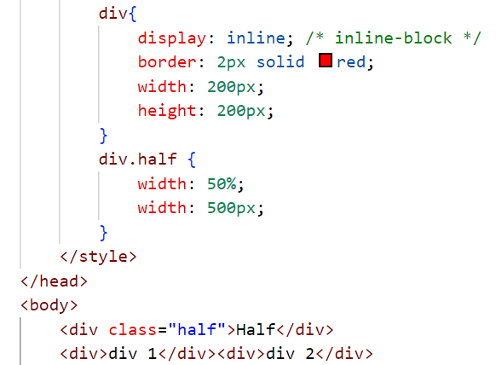
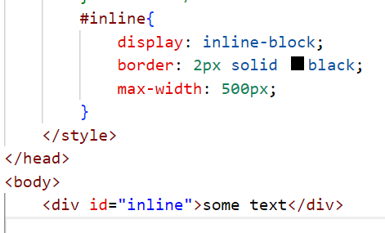
Alignment, border
text-align, border, border-radius
display: block, inline (width, height, margin), inline-block (w, h, m ?). span
width, height
max-width. min-width

Slide 8
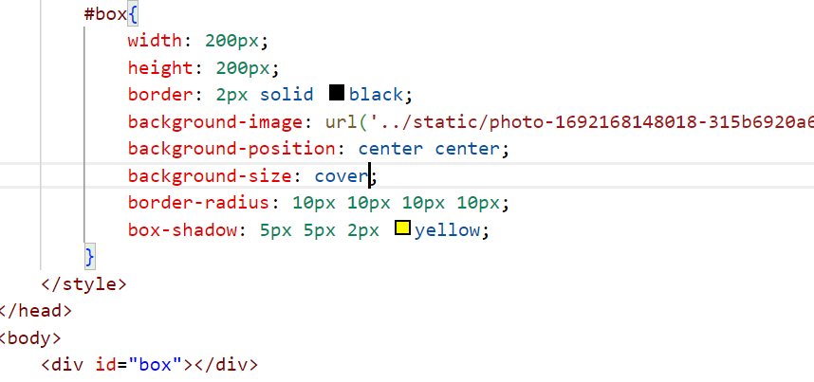
Bringing it all together
box-shadow.

Slide 9
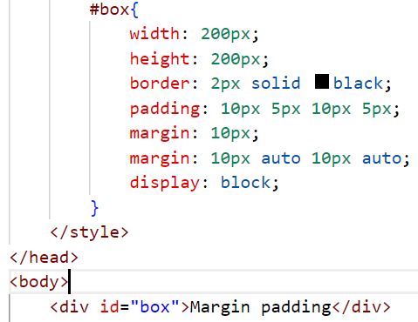
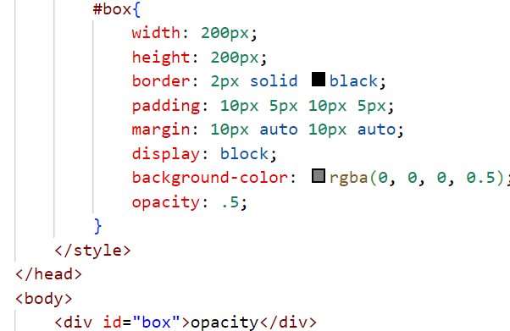
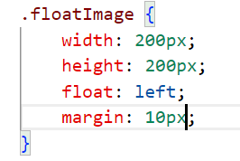
Padding,margin
padding – internal
margin – external
Center?
Opacity
float

Slide 10

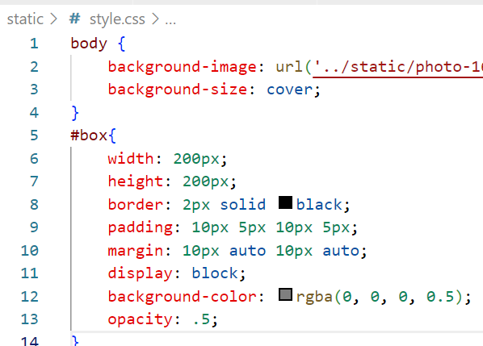
.css files
Why having style in a separate file is important? reuse, clean

Slide 11
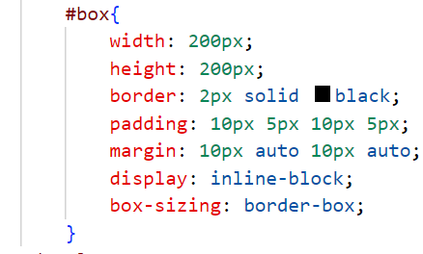
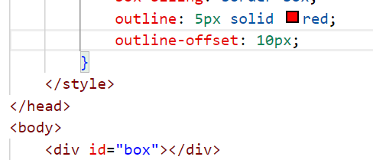
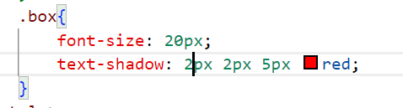
box-sizing, outline, text-shadow
Padding border. Is width really 200px? Inspect!
Outline. Is not part of box measurements, doesn’t show in box model. Inspect!
text-shadow

Slide 12
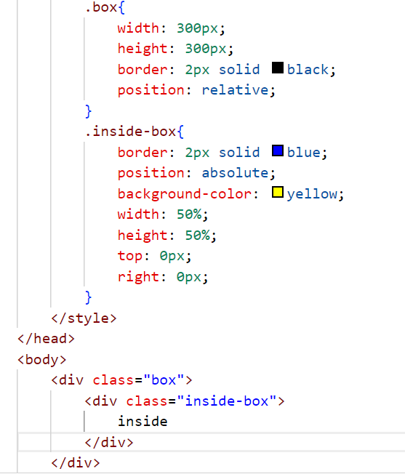
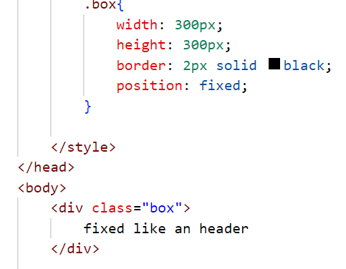
Positions
Position: relative, absolute, sticky, fixed, static (Default)
Important for beautiful sites
relative – to parent
fixed – fixed as you scroll

Slide 13
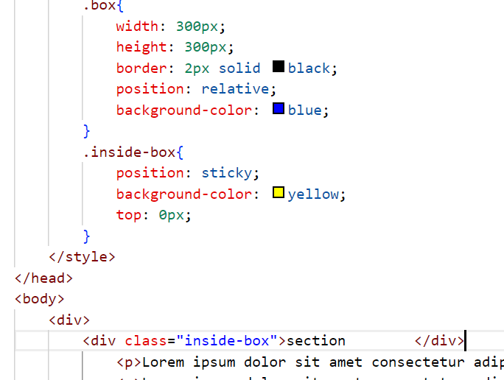
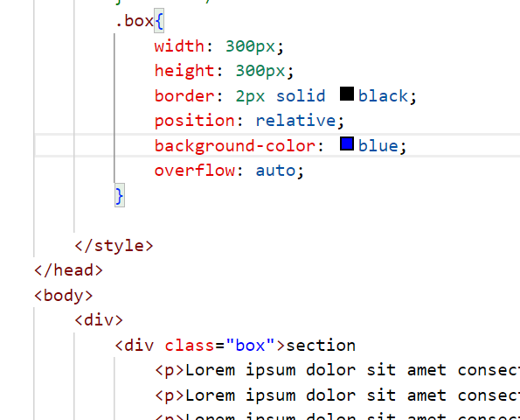
Positions, overflowıng text
sticky – to the parent element
overflow

Slide 14
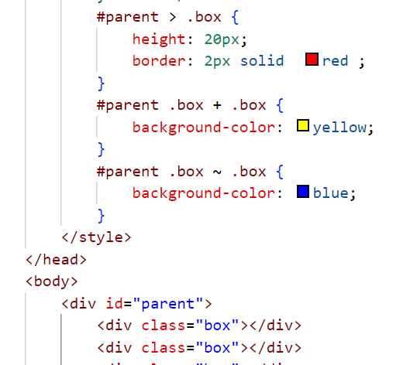
Selectors, advanced
Descendant, adjacent selectors
> + ~

Slide 15
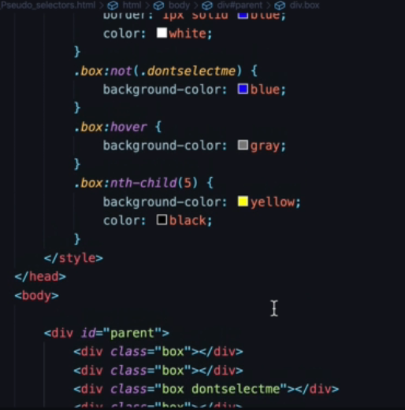
Pseudo selectors
:hover, :not, :nth-child
Important when you can’t edit html i.e Django
They do an action

Slide 16
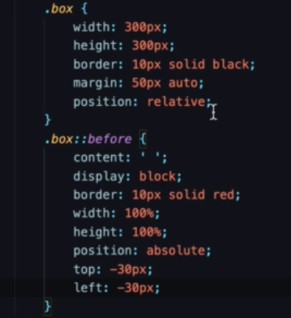

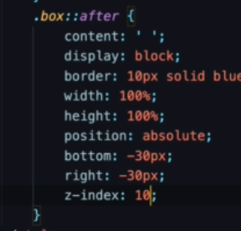
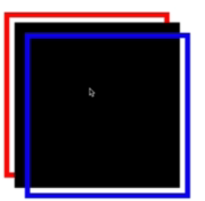
Pseudo elements
::before, ::after
Insert elements before after
z-index – order of element

Slide 17
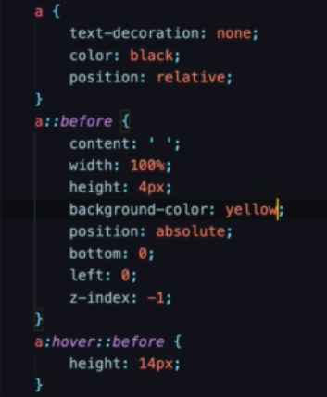
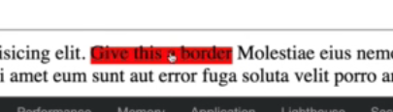
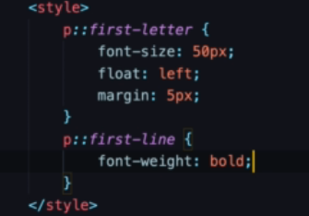

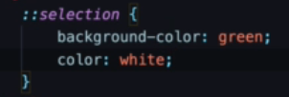
Pseudo elements
Another example
::first-letter, :: first-line
::selection

Slide 18
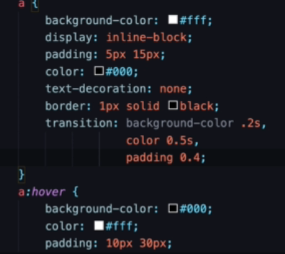
transition
Make changes smoothly
Can be all or specific

Slide 19
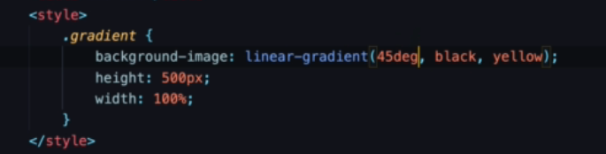

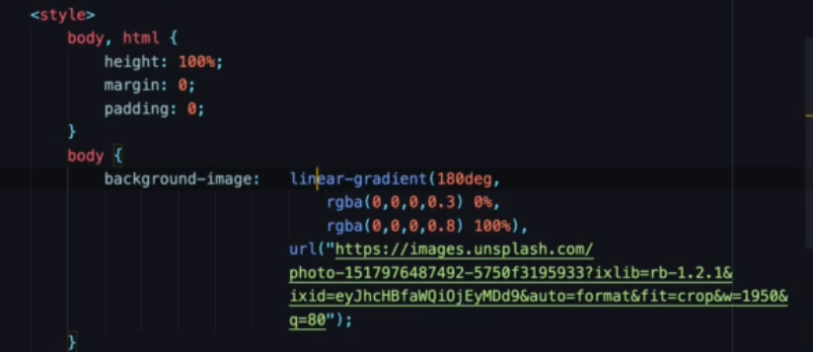
Gradient backgrounds
linear-gradient, radial-gradient
The fade-away
Use a css gradient generator
https://www.colorzilla.com/gradient-editor/
Body background image with gradient

Slide 20
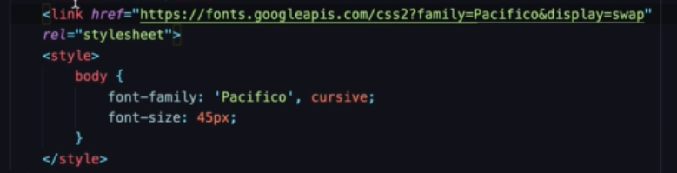
fonts
Add custom fonts
Fonts.google.com

Slide 21
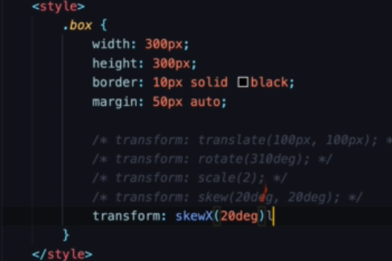
Transform
transform
translate - move
rotate
scale
skew – X and/or Y

Slide 22
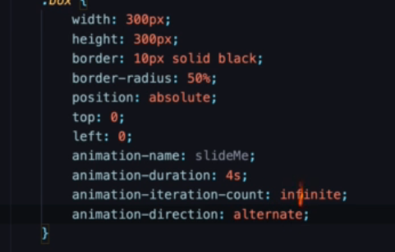
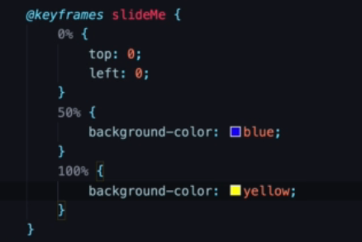
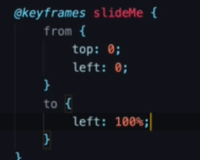
animation
duration,iteration-count, direction
From-to
percentages

Slide 23
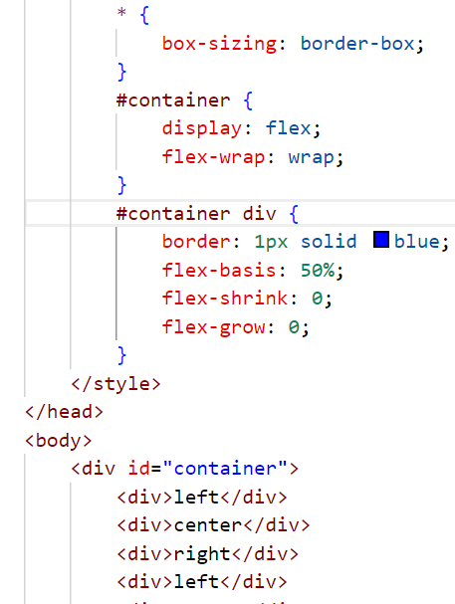
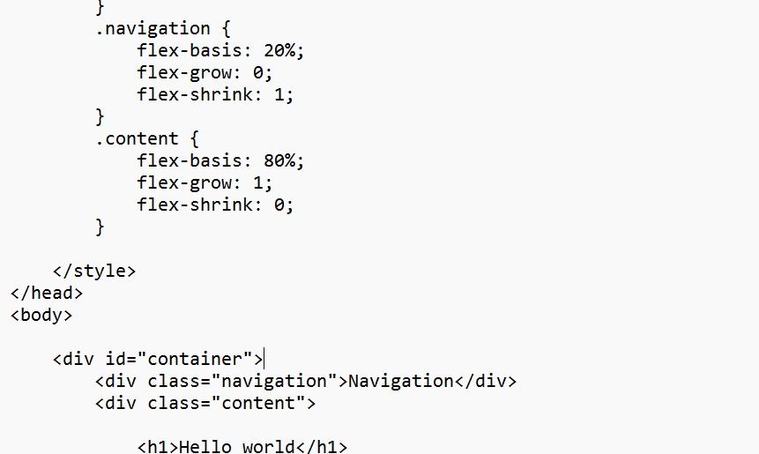
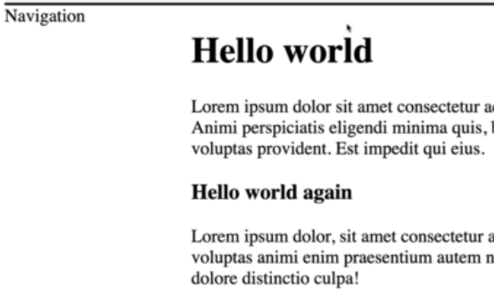
flexbox
A better way to do layouts. No more tables?
display:flex
Flex-wrap, flex-basis, flex-shrink, flex-grow
Navigation, content – a classic usage

Slide 24
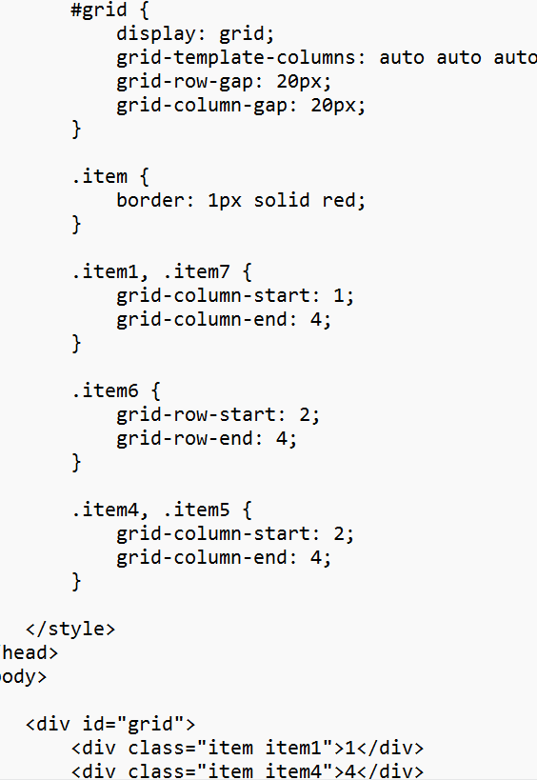
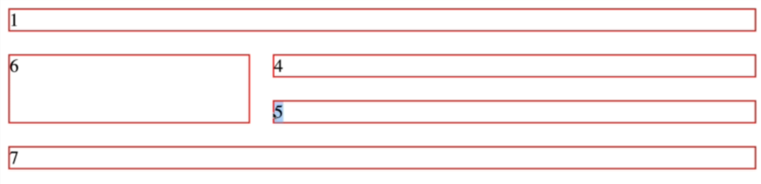
grid
A more popular way to do layouts
display:grid
grid-template-columns, grid-row-gap, grid-column-gap
For responsive design, prefer grid in designs
Can get quite complex

Slide 25
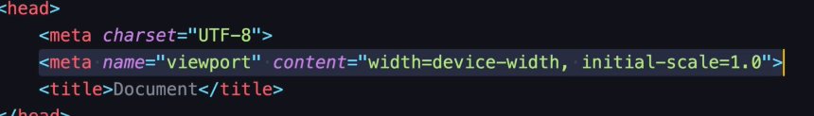
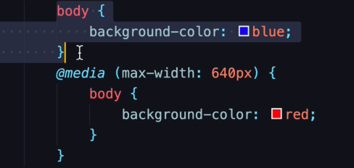
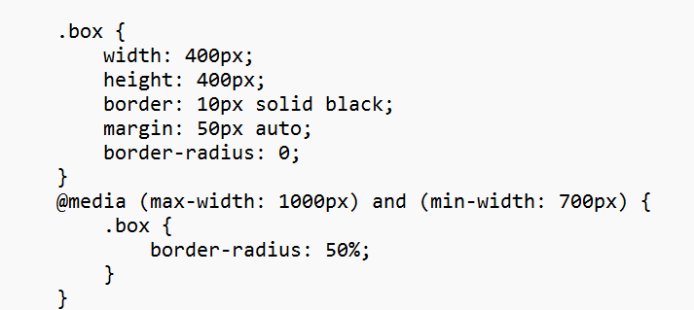
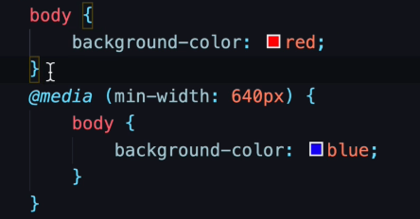
Responsive design
meta name viewport
Inspect – choose between devices
media query
Mobile first or not
Multiple media queries

Slide 26
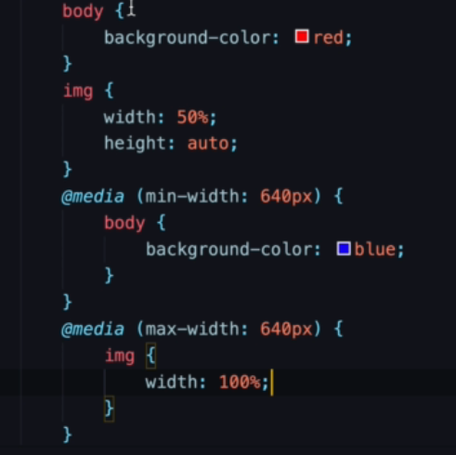
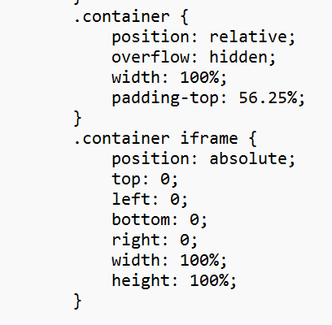
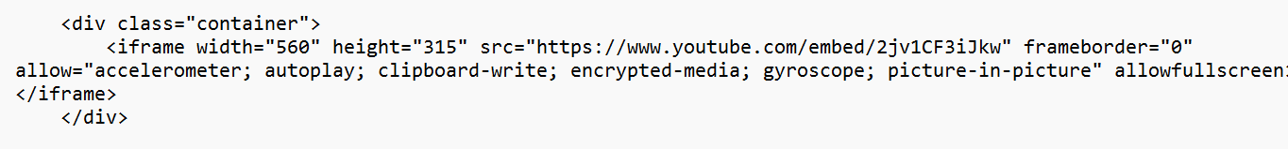
Responsive image, embed
Using width percentage

Slide 27


A responsive layout
Example with display:flex
Use media query to move content on lower widths

Slide 28
Resources
https://developer.mozilla.org/en-US/docs/Web/CSS
https://www.w3schools.com/cssref/
https://goalkicker.com/CSSBook/CSSNotesForProfessionals.pdf
Chat GPT
You cant know everything in CSS. But you need to know WHAT to look for

